Slide 1
Kickstarter Project Success Rate Analysis
Springboard Capstone Project 1
Yan Xu
Sept 4 Cohort

Slide 2


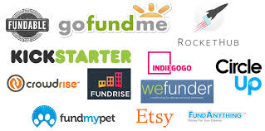
Background
Crowdfunding Website
Wild range of projects
Current project success rate around 50%
Charge a 5% fee if project successfully launched
Major competitors rising up: Indiegogo

Slide 3

Project Goal
Analyze current kickstarter project data and make recommendation to improve the success rate !!!!

Slide 4

Data Description
Data source: Kaggle.com
Number of samples: > 300 K
Date Range: May 2009 - December 2017
Data file type: .csv
Number of features: 15

Slide 5
Data Features
ID - Internal Kickstarter ID
Name - Name of project. A project is a finite work with a clear goal that you’d like to bring to life.
Category - Project Category. There are total of 159 categories.
Main Category - Category of campaign. There are 15 main categories.
Currency - Currency used to support, such as USD. There are total 14 different currencies.
Deadline - Deadline for crowdfunding
Goal - Fundraising goal. The funding goal is the amount of money that a creator needs to complete their project.
Launched - Date launched

Slide 6
Data Features
Pledged - Amount pledged by crowd
State - Current condition the project is in. There are 6 states: Failed, Cancelled, Successful, Live, Suspended, Undefined.
Backers - Number of backers.
Country - Country pledged from.
USD Pledged - Conversion in US dollars of pledged column(Done by Kickstarter)
USD Pledged Real - Conversion in US dollars of pledged column ( from Fixer.io API)
USD Goal Real - Conversion in US dollars of goal column(from Fixer.io API)

Slide 7
Initial Data Assessment
Data type: float - 5 columns, int - 1 column, object - 9 columns
13 columns has 378,661 non-null entries
2 columns - name and usd_pledged contains missing values

Slide 8
Data Cleaning
Drop duplicates
Convert to appropriate data type: ex. Launch date - datetime
Identified and dropped rows with NaN values - 3,797 rows (1 % of the data set)

Slide 9
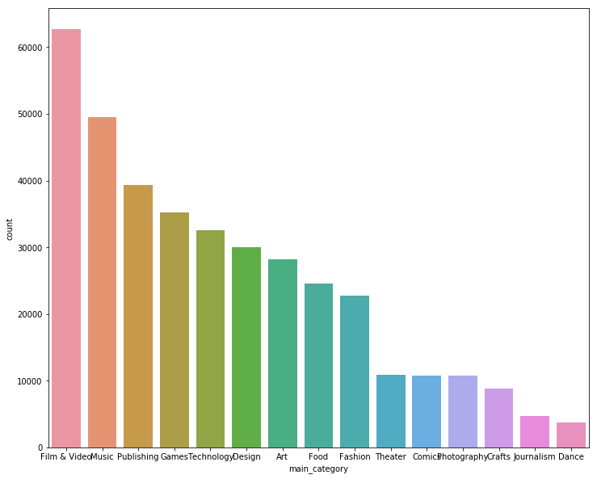
Initial Findings
Total 15 main categories
Top 5 main categories: Film & Video, Music, Publishing, Games, and Technology
Top 5 main categories - 60% of project

Slide 10
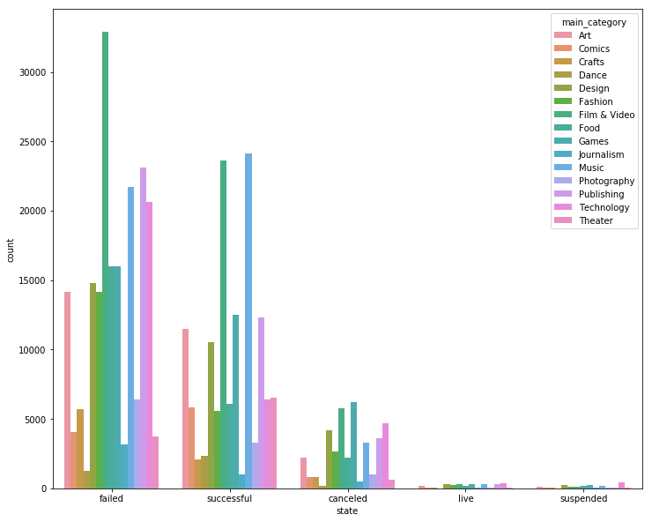
Initial Findings
Roughly 35.7% project succeed
Top two categories with most failed project: Film & Video and Music
Top two categories with most succesful project: Film & Video and Music

Slide 11
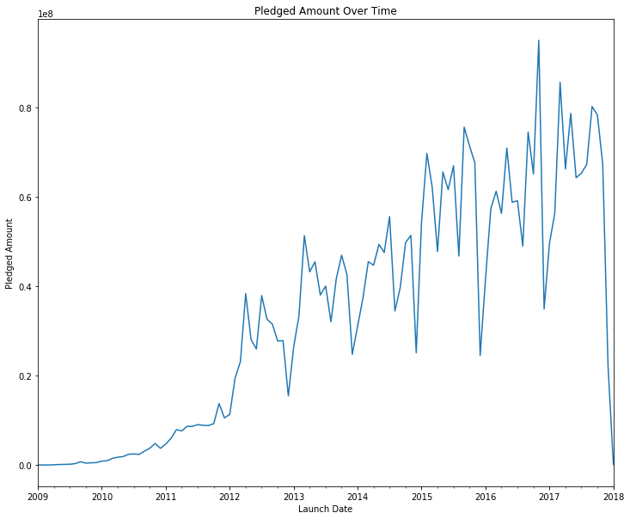
Seasonality
Low pledged amount period
Year end holiday season
Middle of year vacation
Same trend also show in number of backer

Slide 12
Correlation Analysis
Categorical Correlation | Chi-Square Test Value | p-value
State and Main_category | 21526.47 | 0.0
State and Country | 5089.32 | 0.0
State and Currency | 4849.29 | 0.0
Currency and Country | 4873180.0 | 0.0
Numerical Correlation | Pearson Correlation Coefficient
Backers and Pledged Amount | 0.718
Goal Amount and Pledged Amount | 0.007
Goal Amount and Backers | 0.004

Slide 13
Model - Preprocessing
Feature Selection
Numerical: goal, backer
Categorical: main_category, country
Data Encoding - perform one-hot encoding scheme to main_category and country
Training and Testing Dataset split
Training: 60 %
Test: 20%
Validation: 20%

Slide 14
Model - Logistic Regression
Optimized parameter
Penalty = I2 (default)
Cross Validation Parameter ( cv) = 8
C = 10
Model Results
Test Accuracy: 0.7938
Validation Accuracy: 0.7935

Slide 15
Model - KNN
Optimized parameter
N_neighbor = 30
Model Results
Test Accuracy: 0.8117
Validation Accuracy: 0.8144

Slide 16
Model - Ensemble
Optimized parameter
max_samples = 0.5
max_features = 0.8
Model Results
Test Accuracy: 0.809
Validation Accuracy: 0.8116

Slide 17
Results and Conclusion
KNN model with n_neighbor = 30 yields best test and validation accuracy.
Top project categories align with company’s focus on creativity and merchandising
Only 37.5% of projects are successful currently
Obvious seasonality pattern

Slide 18
Recommendations
Do more in depth analysis on projects in Music due to its higher success rate
Hold more holiday/summer vacation campaign to motivate the participation
Promote projects related to holiday during the season

